Slide 1
The Effects of COVID-19 on Music Streaming Patterns
Shanna Greathouse, Douglas Hall Jr., Chris Whitmore
Notes:
Shanna

Slide 2
Background
Chris and DJ are accomplished musicians and Shanna is a music lover so the idea of exploring musical trends was a great fit. We strongly believe in the power of music in healing the community and coping with stress as well as celebrating victories.
2019 - 2021 Spotify data overlaid with the global pandemic’s ups and downs - from the slow onset to the escalation in 2020 and most recently the accelerated release of vaccines - provides a unique opportunity to case-study the ability of music to mirror global moods and sentiments.
Spotify Users
Spotify Streaming Rank
COVID Statistics (March 2021)
150M+
# 2
123M cases
2.7M deaths
USA #1 highest, #8 per capita
January 31 2020 - WHO issues global emergency
Nov 16 2020 - 1st vaccine approved in US for mass distribution
Sources: The Verge, Statista, Worldometers.com, American Journal of Managed Care
Notes:
Shanna
https://www.theverge.com/2021/2/3/22262508/spotify-q4-2020-earnings-subscriber-numbers-users-podcasts-audiobooks
https://www.statista.com/statistics/798125/most-popular-us-music-streaming-services-ranked-by-audience/
https://www.worldometers.info/coronavirus/
https://www.ajmc.com/view/a-timeline-of-covid19-developments-in-2020

Slide 3
Hypothesis
Personal music preferences change based on environmental factors including weather, work schedules, stress levels, etc. COVID has increased stress levels, therefore changing music behavior.
Music preferences may have skewed slower and happier to mitigate stress levels or they could have skewed faster and more aggressive to match stress levels
Music releases have slowed during COVID as artists are not incentivized to release music due to COVID-related barriers such as not having touring options to drive cash flow.
Notes:
Chris
https://developer.apple.com/documentation/applemusicapi/songs
https://developer.spotify.com/documentation/web-api/reference/

Slide 4

Methodology
Comparison of music preferences and traffic pre-covid (2019) to covid (2020) and COVID-rebound (2021 YTD) music patterns in terms of:
Mode, key, valence - how popularity has changed
Method: min/max of 2019, 2020, 2021
Music release patterns by year (2019 - 2020)
Data Source(s): Spotify, Spotipy, Spotify CSV
Notes:
DJ
https://developer.spotify.com/documentation/web-api/reference/
https://www.kaggle.com/yamaerenay/spotify-dataset-19212020-160k-tracks?select=data_w_genres.csv

Slide 5
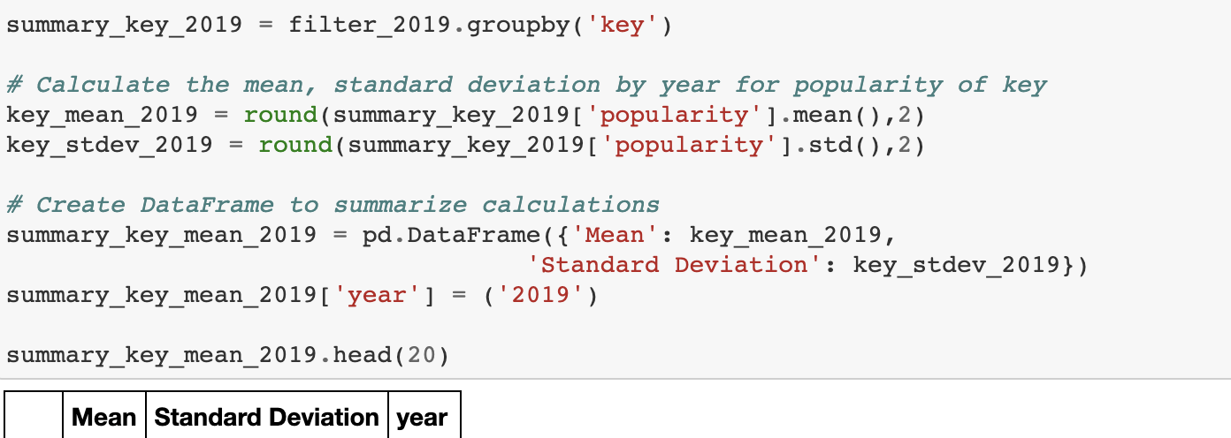
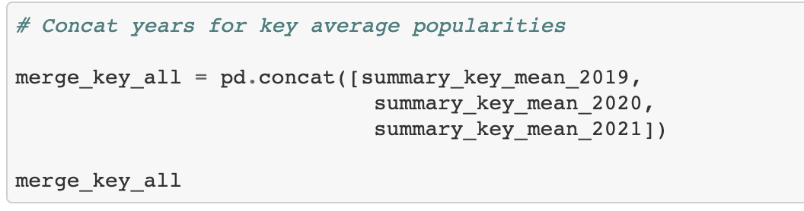
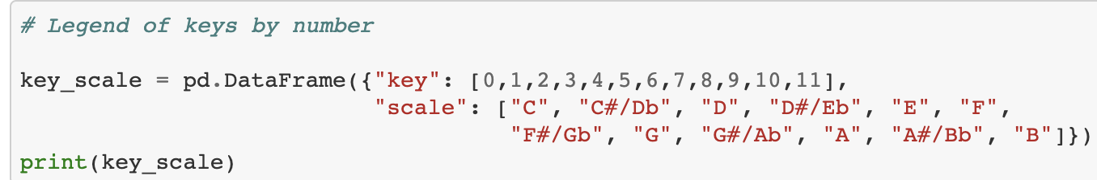
Analysis Process: leveraging Spotipy library
Mode
Group by Year
Average by Song Released
Find the Max Average by Attribute and SD
Code a key for
the data set as a
list
Merge on the
attribute to combine
Plot the Max Mean Popularity vs. the attribute
Max mean highlights in year, which song type will be most popular (type as defined by the variable being evaluated like key, mode, valence)
Key
Valence
Release Song Qty
Group by Year
Length by Year
Notes:
Shanna
https://developer.spotify.com/documentation/web-api/reference/
https://www.kaggle.com/yamaerenay/spotify-dataset-19212020-160k-tracks?select=data_w_genres.csv

Slide 6
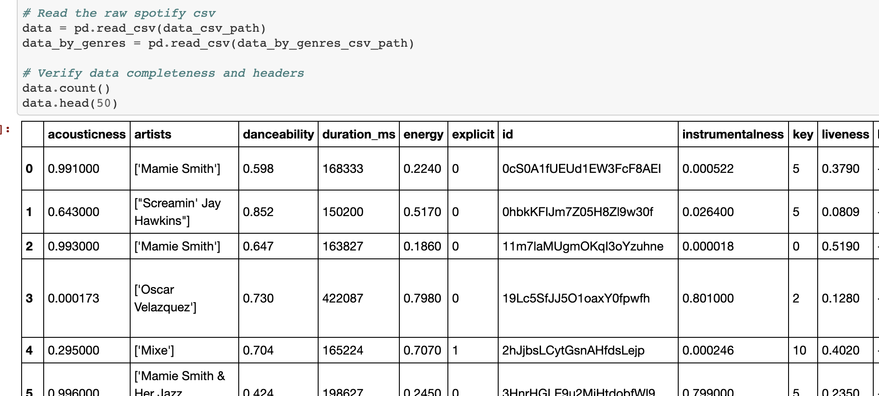
Data Cleaning
Data Fields Available in csv:
acousticness
artists
danceability
duration_ms
energy
explicit
id
instrumentalness
key
liveness
loudness
mode
name
popularity
release_date
speechiness
tempo
valence
year
Performed a test run of data cleaning in excel to verify redundancies, trends, and duplicates
Verified no null values in Jupyter
Verified headers aligned to expected data formats using .head() command in Jupyter
Dropped duplicates by song title and ID (0 removed) in Jupyter
Field used for cleaning
Field used for analyzing
Notes:
DJ

Slide 7
Spotify Popularity
“The popularity of a track is a value between 0 and 100, with 100 being the most popular. The popularity is calculated by algorithm and is based, in the most part, on the total number of plays the track has had and how recent those plays are.
Generally speaking, songs that are being played a lot now will have a higher popularity than songs that were played a lot in the past. Duplicate tracks (e.g. the same track from a single and an album) are rated independently. Artist and album popularity is derived mathematically from track popularity. Note that the popularity value may lag actual popularity by a few days: the value is not updated in real time”
-Spotify API Documentation, March 2021
Popularity was used the key indicator used to evaluate listener preferences for mode (minor / major), and key across data sets grouped by year.
Notes:
DJ

Slide 8
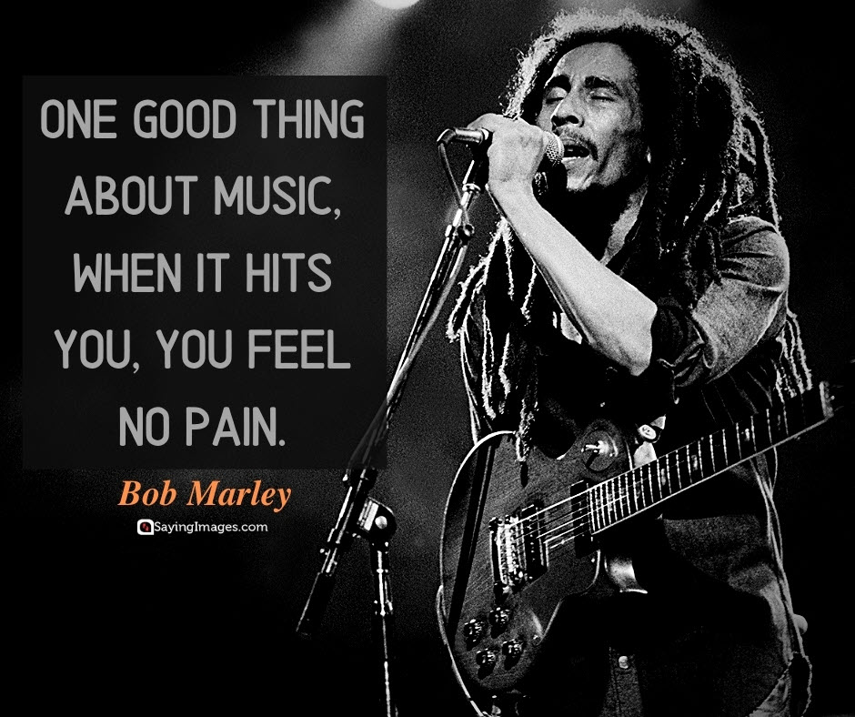
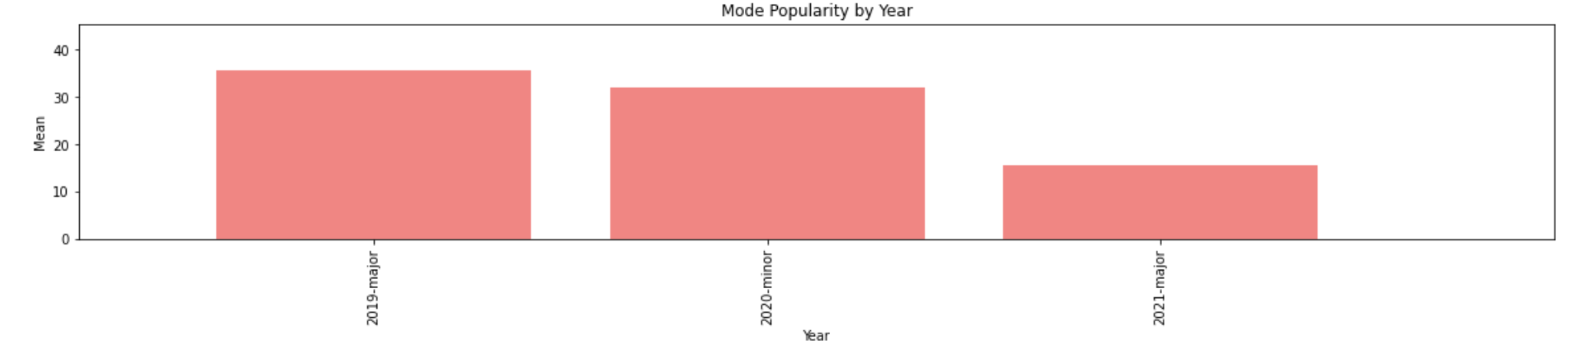
Mode Analysis
Mode describes whether music is minor (somber, melancholy) or Major (triumphant or positive).
Conclusion: Music that is popular released in 2019 and 2021 favors more positive, major music. In 2020, when the world was deep in the pandemic and vaccines were only in trial phase, the popular music released favors somber, minor modes. This can indicate a melancholy or hopeless nature of the listeners and artists releasing music at this time. When there is hope - musical preferences reflect it. When there is hopelessness, music becomes an outlet.
Note that the data has been normalized to account for artists favoring different key releases by year. Mean refers to the average popularity of a released song in a mode in a year. An example would be that a song released in 2020 in a minor key would have a higher likelihood of being popular compared to a major released in that year.
Notes:
Chris

Slide 9
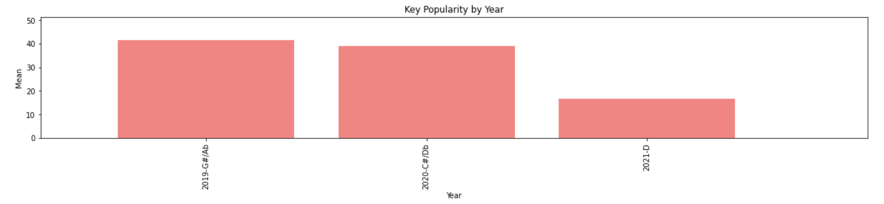
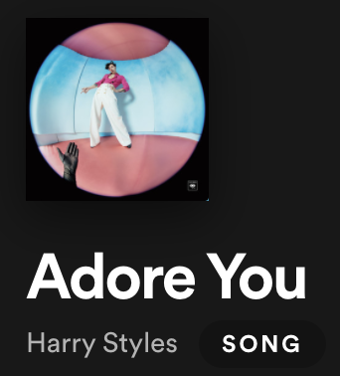
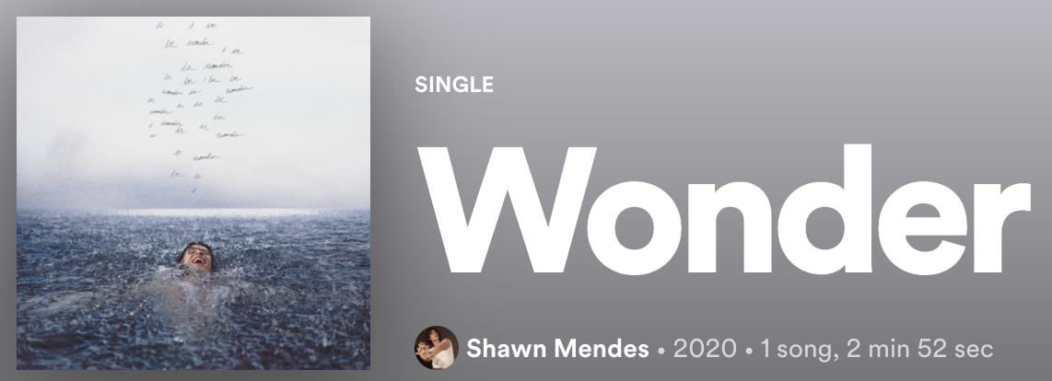
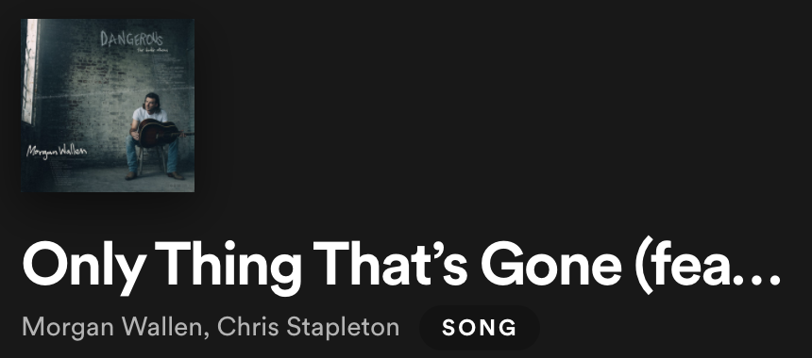
Key
The group of pitches or scales that form a musical composition
Key % Songs Released (All Time)
C - 12.6%
G - 12.3%
D - 10.8%
A - 10.4%
F - 9.5%
C# / D - 7.8%
E - 7.6%
A#/Bb - 7.1%
B - 6.3%
G# / Ab - 6.1%
F#/Gb - 5.3%
D#/Eb - 4.2%
The key of uneasiness and worry
The key of lamentation
The key of triumph
2019 released popularity favored G#, a key which is historically less common and uneasy - potentially of reflecting upcoming pandemic concerns
2020 popularity likewise favors dissonant, and historically uncommon keys.
2021 favors the more common and upbeat key of D, indicating a positivity and optimism not seen in the prior two years’ listening preferences.
Most Popular Song in Key by Release Year⁽¹⁾
Other Popular Songs in Key
White Christmas
Over the Rainbow
No Scrubs
Smells Like Teen Spirit
We Found Love
No Woman No Cry
Jingle Bell Rock
Sittin’ on the Dock of the Bay
Joy to the World
Source(s): Spotify, Wikipedia, Western Michigan University 1) Songs are aggregated by title to account for multiple arrangements
Notes:
DJ - each thumbnail is a link
https://en.wikipedia.org/wiki/Key_(music)
https://wmich.edu/mus-theo/courses/keys.html

Slide 10
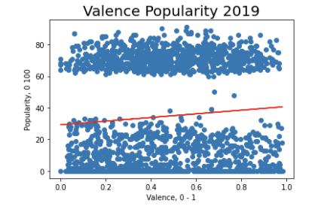
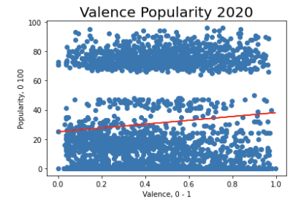
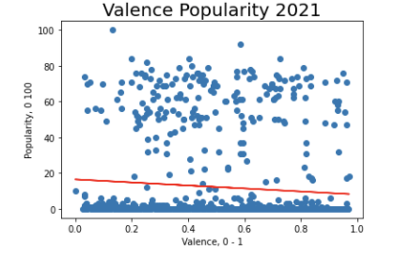
Valence
“The musical positiveness conveyed by a track. Tracks with high valence sound more positive (happy, cheerful, euphoric), while tracks with low valence sound more negative (sad, depressed, angry).”
-Spotify Community Forum
R2
Conclusion(s)
Positivity is not a strong predictor of popularity, regardless of release year.
The most positive songs released in 2020 have 42% more likelihood of being popular than the most positive songs released in 2019 indicating 2020 was a year people were searching for more positive, upbeat music
Popularity tends to bifurcated into above 60 and below 40 for songs, but 2021 shows much more popularity ranges suggesting more diverse listening behaviors
0.007 Weak positive correlation between happy music and popularity
PRE-COVID
.010 Weak correlation but stronger than 2019 by 42% suggesting more upbeat music was a stronger predictor of popularity than in 2019
COVID
Limitation(s) & Enhancement(s)
Data does not indicate popularity in a year, but rather current popularity by year released
Regionalizing data and trending against COVID trends by country
Layering mental health trends with popularity trends to indicate whether it is
2021 is a partial year and should be grossed up or other data seasonalized to account for variations
.009 Weak and slightly negative correlation between happy music and popularity. Note 2021 is a partial year and seasonality has not been factored
COVID REBOND
Source(s): Spotify API, MHA National (2021),
-Spotify Community Forum
Notes:
Shanna
https://community.spotify.com/t5/Spotify-for-Developers/Valence-as-a-measure-of-happiness/td-p/4385221#:~:text=In%20Spotify's%20API%20is%20something,sad%2C%20depressed%2C%20angry).
https://mhanational.org/issues/2020/mental-health-america-all-data

Slide 11

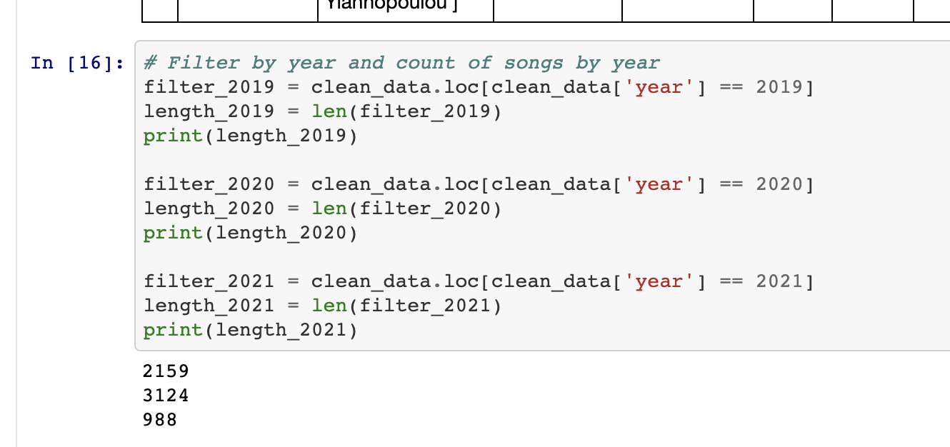

Songs Released
3124 (+44%)
The theory was music would have slowed release in 2020 as a result of less touring monetization opportunities after album release. However, 2020 actually realized an increase of 44% YOY in song releases. People had more down time for creative outlets including music production. In 2021, the daily release rate has skyrocketed but seasonality has not been accounted for.
2159
988 (+400% based on daily release rate)
2019
2020
2021
Notes:
Chris
Math for grossing up 2021:
988 in 6% of 2021 by days grosses up to ~15,679 total songs in the year at the same rate (43 songs per day). Limitations include not accounting for seasonality so it’s an avg rate of 43 songs per day

Slide 12

Limitations
Data set only includes live popularity - not popularity by release year. This creates a recall bias that is best illustrated in the correlations between valence and popularity. In past release years, there are few popularity scores in the middle because songs are forgotten about 2 years later that weren’t meaningful.
Data was not segmented by geographic area, and each country experienced different COVID rates
COVID was treated qualitatively and rates were overlaid with the data. Given more time, WHO data would have been overlaid and statistical significance would have been calculated.
Genres are very specific. Given more time, there would have been groupings of genres to generalize trends and then this would have been examined for preference changes
Valence and popularity both have an algorithm that is not publicly available used to calculate, leaving ambiguity. Given more time, we would have examined pure listens count against tempo, key, and liveliness for a more defined understanding of its relationship to popularity.
Notes:
Chris

Slide 13

Conclusion and Recommended Next Steps
2019 = nervous energy, slight dissonance, but still a preference for major (more upbeat keys). Music releases were moderate as musicians focused on touring for monetization.
2020 = dissonance amplified. Music releases and creative energy lept as people sought out outlets to pass the time during quarantine and a means to cope with the economic, political, and health crisis of the time.
2021 = year of optimism. Though quarantines are slowly lifting, music release daily rates skyrocketed and music popularity has been focused on major keys again with a triumphant, upbeat favoritism. As quarantine lifts, we expect music releases to slow from ~40 per day to closer to 10 - 20 (2019 and 2020 rate median).
Music will continue to be an outlet for people during times of distress and listening patterns clearly change based on outside stressors. Music tends to mirror the emotions of the population.
Next Steps:
-Overlay geographic data and COVID rates for more specific correlations
-Run t tests for statistical significance
-Extend baseline from 2019 to to 2009 to 2019 to understand the base trend (eg. Spotify base may already be growing 10% per year for users and it has an exponential pattern…)
Notes:
Shanna

